Slide 1
Developing a Machine Learning Model
ISDS 7075 Summer 2025 Taylor Kocher, Ryan McGiffin, Eric Lekas, Cameron Slaugh

Slide 2

About the Dataset
Chicago Police Department’s Citizen Law Enforcement Analysis and Reporting (CLEAR) system
Contains geographical information, outcome of crime (arrest) and/or whether it was a domestic dispute
Utilized 2016 data to create a Machine Learning (ML) model

Slide 3
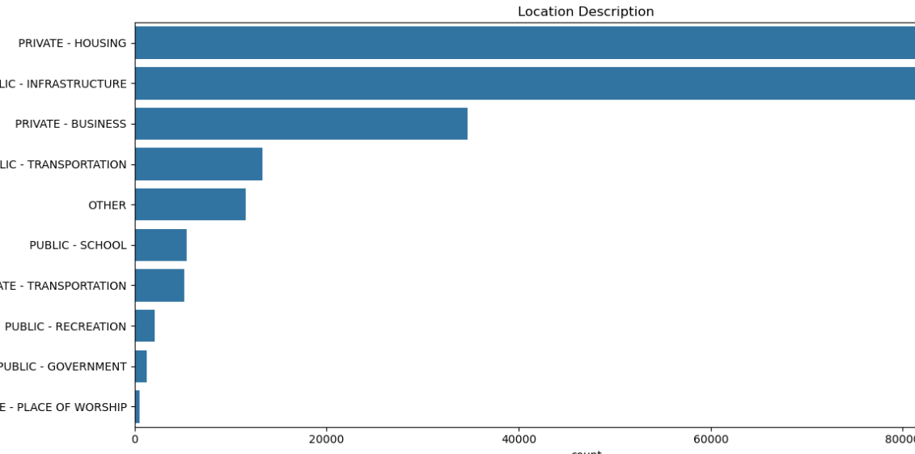
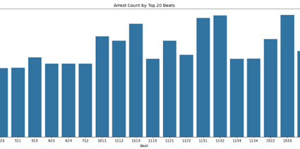
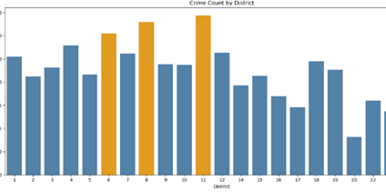
Frame the Problem
Data can be utilized to answer various business objectives
# of Crimes by Location
# of Crimes by District
# of Arrest by Beat
Main Objective of ML Model: predict the likelihood of an arrest based on various factors, such as type, location, and time of day

Slide 4
Initial Thoughts & Assumptions
Violent crimes to lead to more arrests
Drug-related crimes have a high number of arrests
Crimes that happen in the summer or during the afternoon result in more
School grounds would have more violent crimes
Most crimes happen in public places connected to infrastructure, as well as in private homes, along with a higher proportion of violent crimes
Notes:
Before building our model, we made several assumptions based on what we already know about crime and a first look at the data. We expected violent crimes to lead to more arrests because they are more serious and get more police attention. We also thought drug-related crimes would have a high number of arrests since police often target those specifically. Crimes that happen in the summer or during the afternoon were assumed to result in more arrests, since there are usually more people around and more police activity at those times. We believed that school grounds, especially public schools, would have more violent crimes, even if the total number of crimes there is low. Finally, we expected most crimes to happen in public places connected to infrastructure, as well as in private homes, and that these areas would also have a higher proportion of violent crimes compared to non-violent crimes. These ideas helped guide how we prepared the data and what we looked for in our model.

Slide 5

Data Wrangling
Dropped unnecessary columns
Updated data types
Removed rows with missing values
Binned data
Split testing and training data
Data visualization

Slide 6
Modeling
[Which models did we try and why?]
[Which is the preferred model?]

Slide 7
Outcome
[Include data visualization (graphs, charts, etc.) into our observations]

Slide 8
Interesting Facts
[What worked, what did not work, assumptions, surprises, limitations, etc.]
Notes:
Discuss what worked
Discuss what did not work
Assumptions
Surprises
Limitations

